Slide 1

CSC334 - Parallel & Distributed Computing
Chapter 4: Communication
Mr. Aoun Haider, Ms. Muntaha Amjad

Slide 2
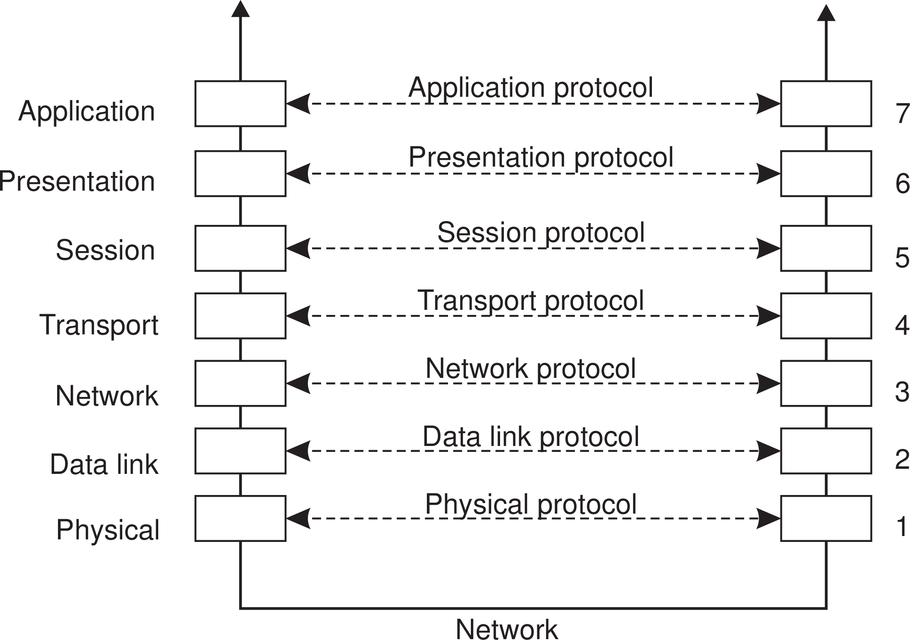
Communication
Foundations
Basic networking model
Drawbacks
Focus on message-passing only
Often unneeded or unwanted functionality
Violates access transparency
Layered Protocols

Slide 3
Low-level layers
Communication Foundations
Recap
Physical layer: contains the specification and implementation of bits, and their transmission between sender and receiver
Data link layer: prescribes the transmission of a series of bits into a frame to allow for error and flow control
Network layer: describes how packets in a network of computers are to be routed.
Observation
For many distributed systems, the lowest-level interface is that of the network layer.
Layered Protocols

Slide 4
Communication
Foundations
Transport Layer
Important
The transport layer provides the actual communication facilities for most distributed systems.
Standard Internet protocols
TCP: connection-oriented, reliable, stream-oriented communication
UDP: unreliable (best-effort) datagram communication
Layered Protocols

Slide 5
Middleware layer
Communication Foundations
Observation
Middleware is invented to provide common services and protocols that can be used by many different applications
A rich set of communication protocols
(Un)marshaling of data, necessary for integrated systems
Naming protocols, to allow easy sharing of resources
Security protocols for secure communication
Scaling mechanisms, such as for replication and caching
Note
What remains are truly application-specific protocols... such as?
Layered Protocols

Slide 6
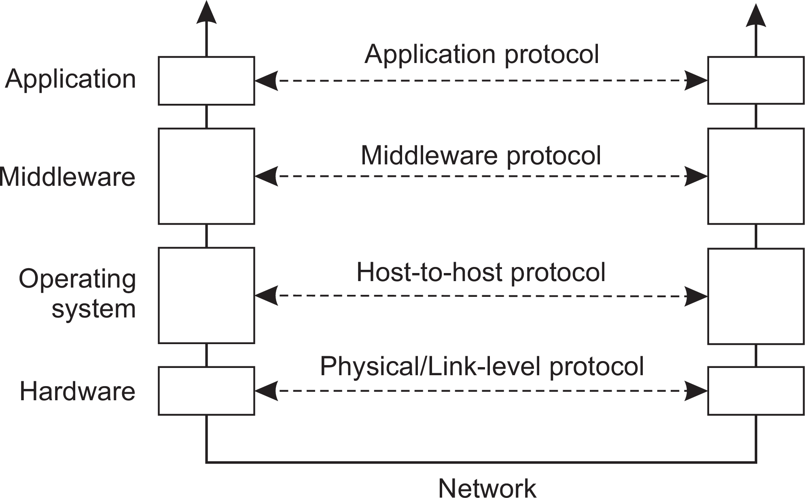
Communication
Foundations
An adapted layering scheme
Layered Protocols

Slide 7
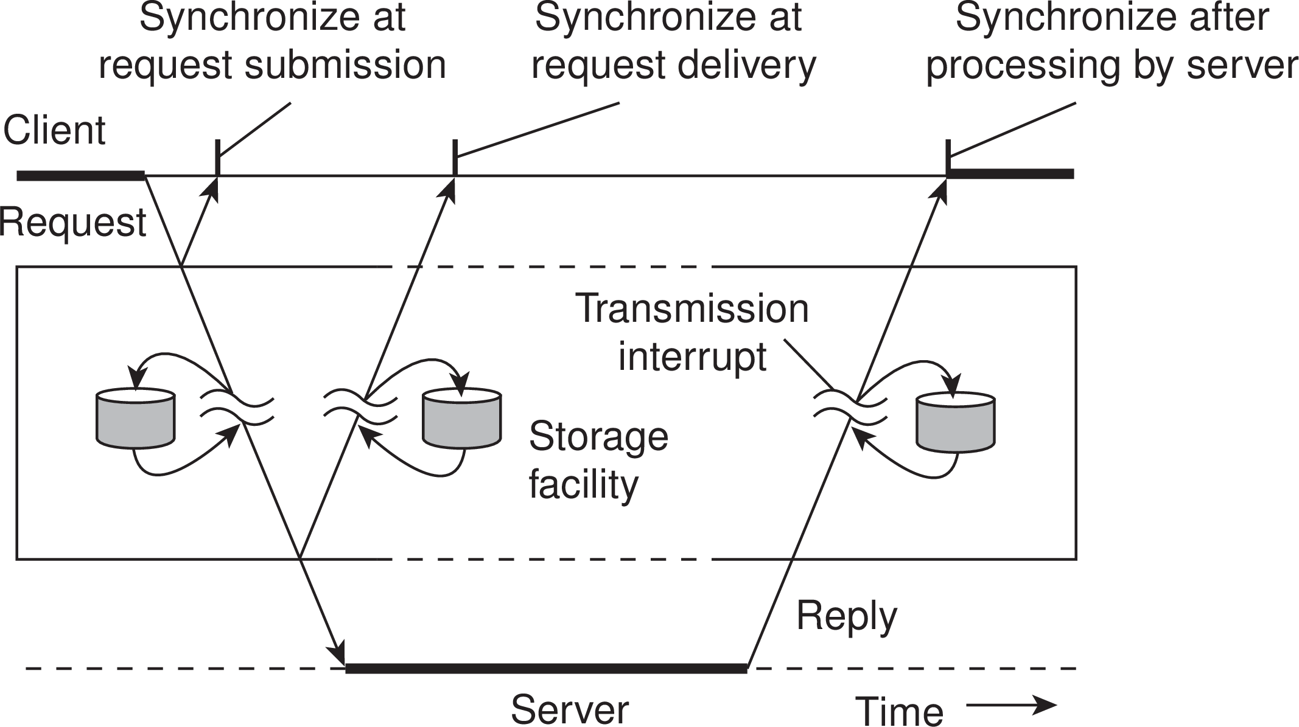
Communication
Foundations
Types of communication
Distinguish...
Transient versus persistent communication
Asynchronous versus synchronous communication
Types of Communication

Slide 8
Communication
Foundations
Types of communication
Transient versus persistent
Transient communication: Comm. server discards message when it cannot be delivered at the next server, or at the receiver.
Persistent communication: A message is stored at a communication server as long as it takes to deliver it.
Types of Communication

Slide 9
Communication
Foundations
Types of communication
Places for synchronization
At request submission
At request delivery
After request processing
Types of Communication

Slide 10
Communication
Foundations
Client/Server
Some observations
Client/Server computing is generally based on a model of transient synchronous communication:
Client and server have to be active at the time of communication
Client issues request and blocks until it receives reply
Server essentially waits only for incoming requests, and subsequently processes them
Types of Communication

Slide 11
Communication
Foundations
Client/Server
Some observations
Client/Server computing is generally based on a model of transient synchronous communication:
Client and server have to be active at the time of communication
Client issues request and blocks until it receives reply
Server essentially waits only for incoming requests, and subsequently processes them
Drawbacks synchronous communication
Client cannot do any other work while waiting for reply
Failures have to be handled immediately: the client is waiting
The model may simply not be appropriate (mail, news)
Types of Communication

Slide 12
Communication
Foundations
Messaging
Message-oriented middleware
Aims at high-level persistent asynchronous communication:
Processes send each other messages, which are queued
Sender need not wait for immediate reply, but can do other things
Middleware often ensures fault tolerance
Types of Communication

Slide 13
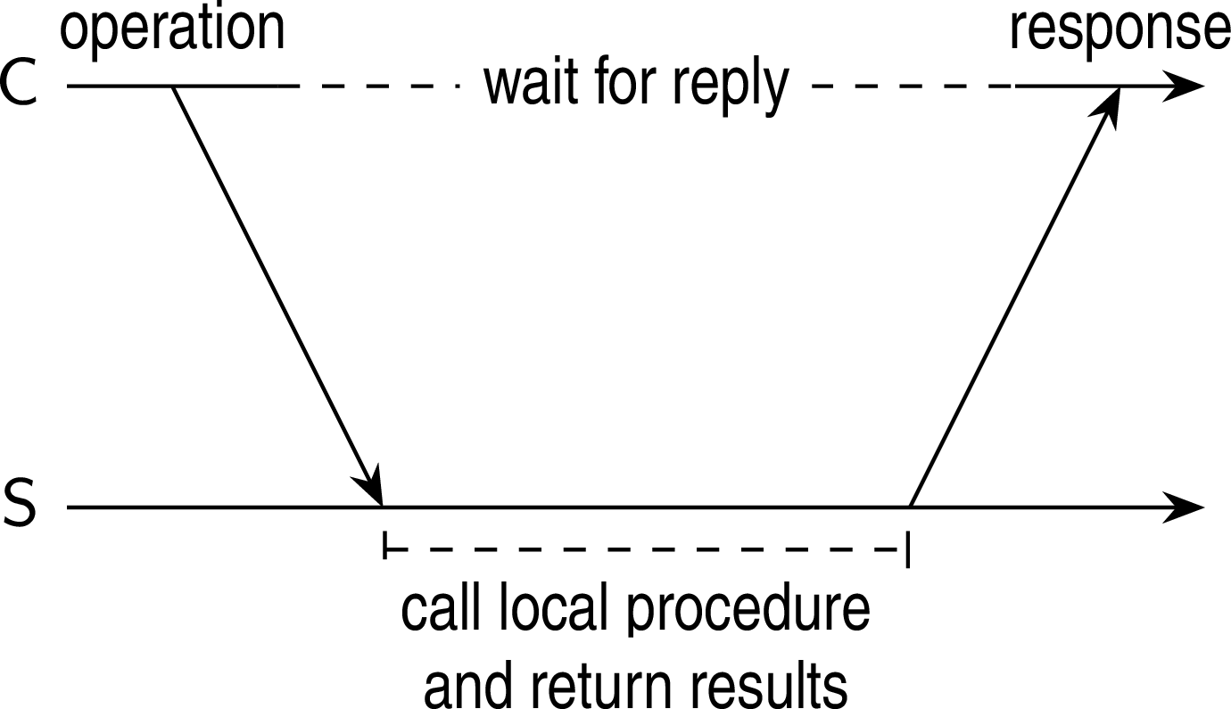
Basic RPC operation
Communication Remote procedure call
Observations
Application developers are familiar with simple procedure model
Well-engineered procedures operate in isolation (black box)
There is no fundamental reason not to execute procedures on separate machine
Conclusion
Communication between caller & callee can be hidden by using procedure-call mechanism.
Basic RPC operation

Slide 14
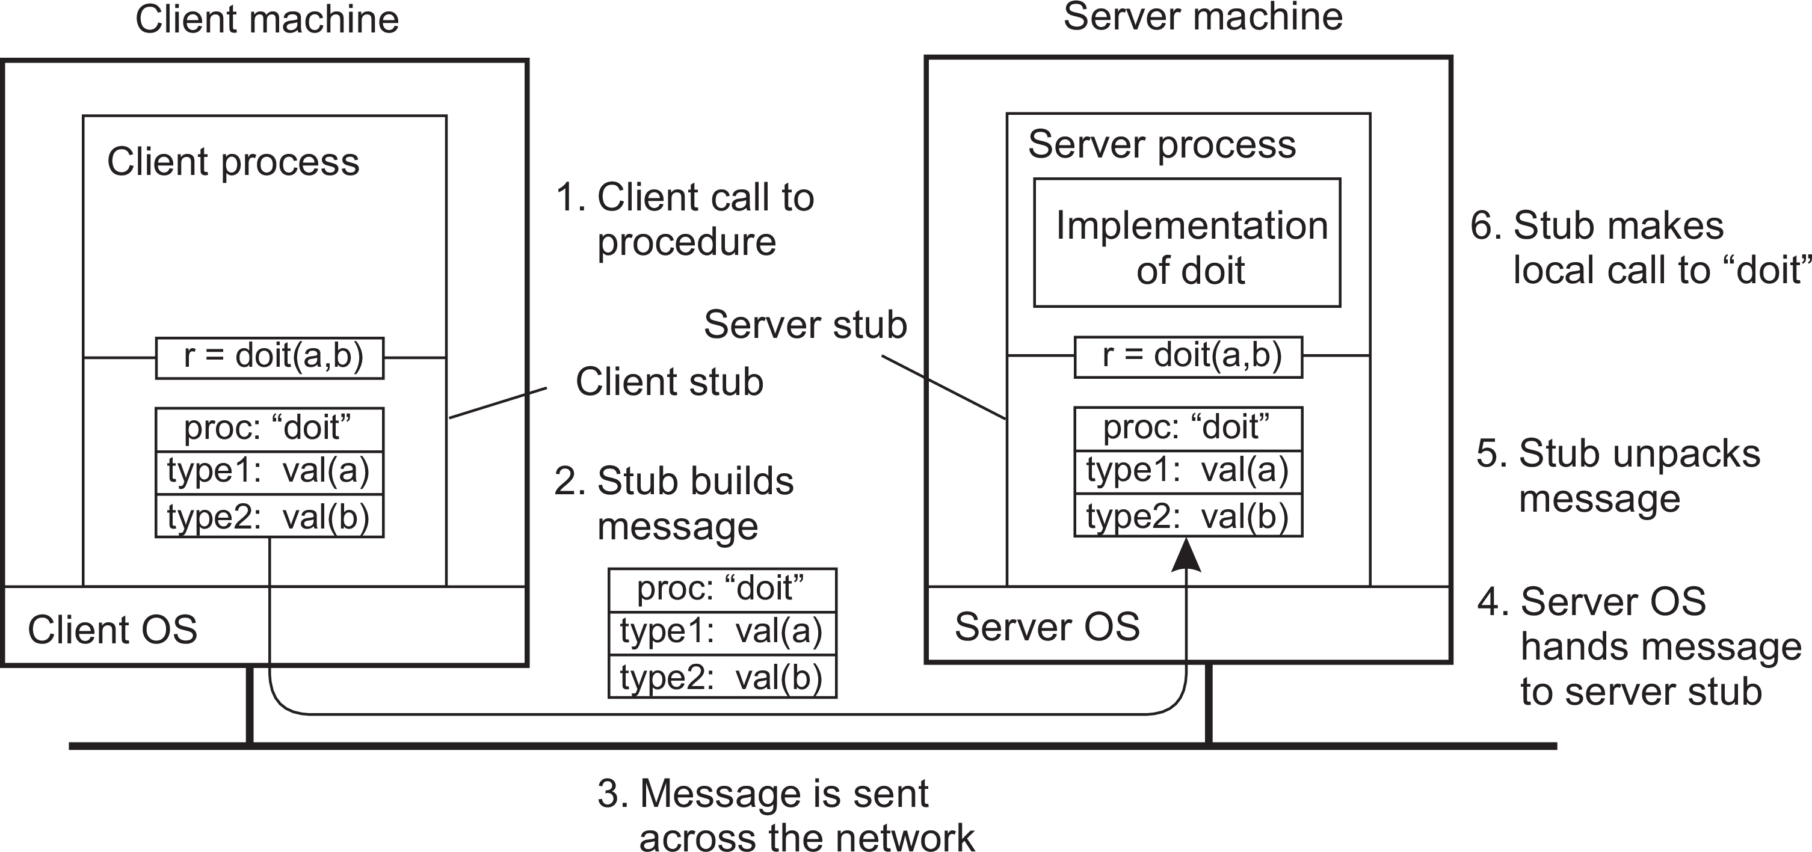
Communication
Remote procedure call
Basic RPC operation
Client procedure calls client stub.
Stub builds message; calls local OS.
OS sends message to remote OS.
Remote OS gives message to stub.
Stub unpacks parameters; calls server.
Server does local call; returns result to stub.
Stub builds message; calls OS.
OS sends message to client’s OS.
Client’s OS gives message to stub.
Client stub unpacks result; returns to client.
Basic RPC operation

Slide 15
RPC: Parameter passing
Communication Remote procedure call
There’s more than just wrapping parameters into a message
Client and server machines may have different data representations (think of byte ordering)
Wrapping a parameter means transforming a value into a sequence of bytes
Client and server have to agree on the same encoding:
How are basic data values represented (integers, floats, characters)
How are complex data values represented (arrays, unions)
Conclusion
Client and server need to properly interpret messages, transforming them into machine-dependent representations.
Parameter passing

Slide 16
RPC: Parameter passing
Communication Remote procedure call
Some assumptions
Copy in/copy out semantics: while procedure is executed, nothing can be assumed about parameter values.
All data that is to be operated on is passed by parameters. Excludes passing references to (global) data.
Parameter passing

Slide 17
RPC: Parameter passing
Communication Remote procedure call
Some assumptions
Copy in/copy out semantics: while procedure is executed, nothing can be assumed about parameter values.
All data that is to be operated on is passed by parameters. Excludes passing references to (global) data.
Conclusion
Full access transparency cannot be realized.
Parameter passing

Slide 18
RPC: Parameter passing
Communication Remote procedure call
Some assumptions
Copy in/copy out semantics: while procedure is executed, nothing can be assumed about parameter values.
All data that is to be operated on is passed by parameters. Excludes passing references to (global) data.
Conclusion
Full access transparency cannot be realized.
A remote reference mechanism enhances access transparency
Remote reference offers unified access to remote data
Remote references can be passed as parameter in RPCs
Note: stubs can sometimes be used as such references
Parameter passing

Slide 19
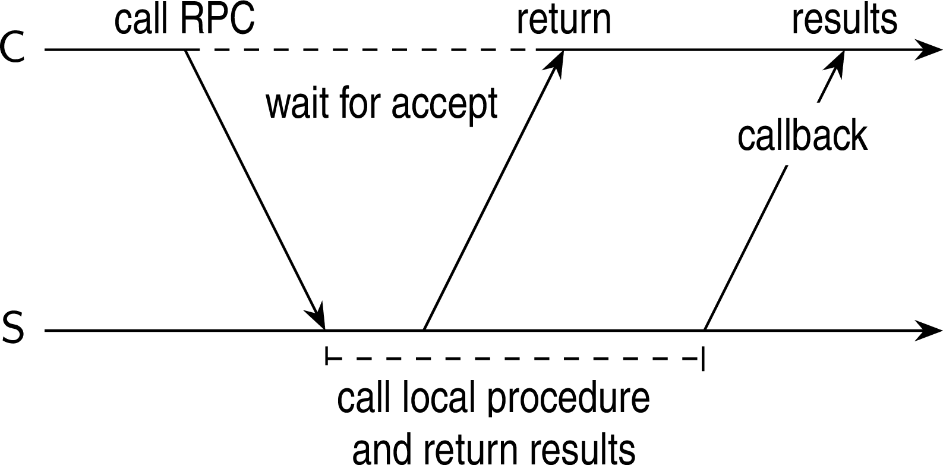
Asynchronous RPCs
Communication Remote procedure call
Essence
Try to get rid of the strict request-reply behavior, but let the client continue without waiting for an answer from the server.
Variations on RPC

Slide 20
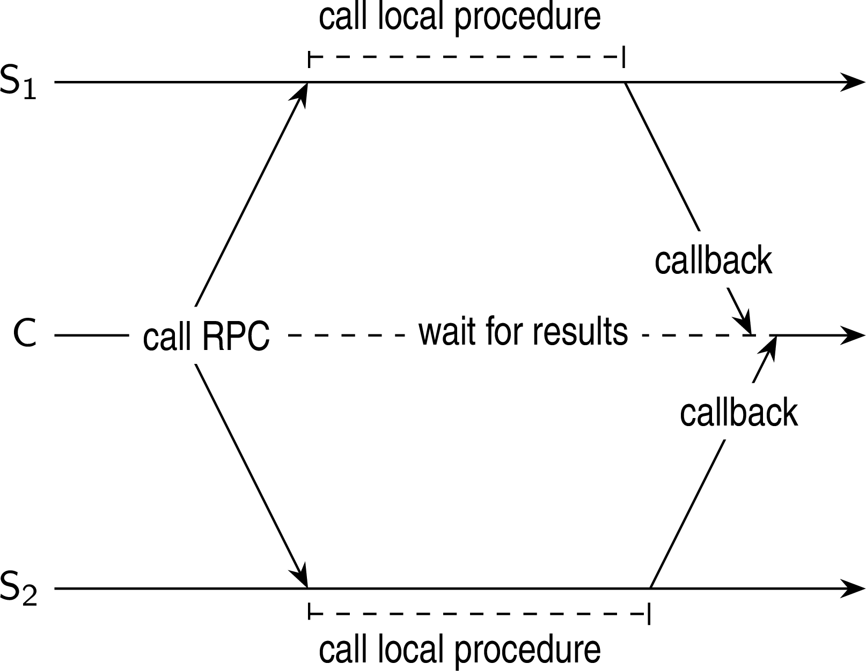
Communication
Remote procedure call
Sending out multiple RPCs
Essence
Sending an RPC request to a group of servers.
Variations on RPC

Slide 21
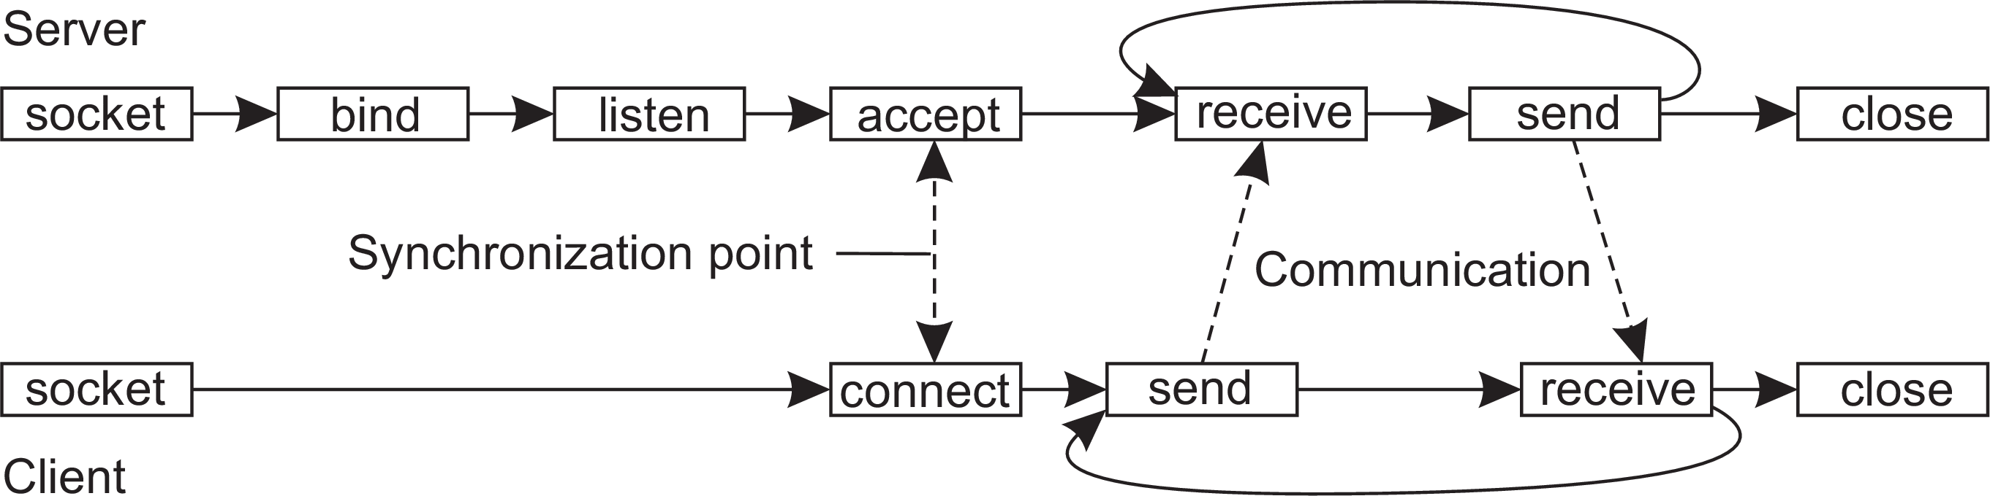
Communication
Message-oriented communication
Transient messaging: sockets
Berkeley socket interface
Operation | Description
socket bind listen accept connect send receive close | Create a new communication end point Attach a local address to a socket Tell operating system what the maximum number of pending connection requests should be Block caller until a connection request arrives Actively attempt to establish a connection Send some data over the connection Receive some data over the connection Release the connection
Simple transient messaging with sockets

Slide 22
Communication
Message-oriented communication
Sockets: Python code
Server
1 from socket import *
2
3 class Server:
4
5
6
7
8
9
10
11
12
13
def run(self):
s = socket(AF_INET, SOCK_STREAM) s.bind((HOST, PORT))
s.listen(1)
(conn, addr) = s.accept() # returns new socket and addr. client
while True: # forever
data = conn.recv(1024) # receive data from client
if not data: break # stop if client stopped
conn.send(data+b"*") conn.close()
# return sent data plus an "*"
# close the connection
Client
1 class Client:
2
3
4
5
6
7
8
9
def run(self):
s = socket(AF_INET, SOCK_STREAM)
s.connect((HOST, PORT)) # connect to server (block until accepted)
s.send(b"Hello, world") # send same data
data = s.recv(1024) # receive the response
print(data) s.send(b"") s.close()
# print what you received # tell the server to close # close the connection
Simple transient messaging with sockets

Slide 23
Making sockets easier to work with
Communication Message-oriented communication
Observation
Sockets are rather low level and programming mistakes are easily made. However, the way that they are used is often the same (such as in a client-server setting).
Alternative: ZeroMQ
Provides a higher level of expression by pairing sockets: one for sending messages at process P and a corresponding one at process Q for receiving messages. All communication is asynchronous.
Three patterns
Request-reply
Publish-subscribe
Pipeline
Advanced transient messaging

Slide 24
Communication
Message-oriented communication
Request-reply
1 import zmq
2
3 def server():
4 context = zmq.Context()
5 socket = context.socket(zmq.REP)
6 socket.bind("tcp://*:12345")
7
8 while True:
9 message = socket.recv()
10 if not "STOP" in str(message):
11 reply = str(message.decode())+’*’
12 socket.send(reply.encode())
13 else:
14 break
# create reply socket
# bind socket to address
# wait for incoming message # if not to stop...
# append "*" to message
# send it away (encoded)
# break out of loop and end
15
16 def client():
17
18
19
20
21
22
23
24
context = zmq.Context()
socket = context.socket(zmq.REQ) # create request socket
socket.connect("tcp://localhost:12345") # block until connected
socket.send(b"Hello world") message = socket.recv() socket.send(b"STOP") print(message.decode())
# send message
# block until response # tell server to stop # print result
Advanced transient messaging

Slide 25
Communication
Message-oriented communication
Publish-subscribe
1 import multiprocessing
2 import zmq, time
3
4 def server():
5 context = zmq.Context()
6 socket = context.socket(zmq.PUB)
7 socket.bind("tcp://*:12345")
8 while True:
9 time.sleep(5)
10 t = "TIME " + time.asctime()
11 socket.send(t.encode())
12
# create a publisher socket # bind socket to the address
# wait every 5 seconds
# publish the current time
13 def client():
14
15
16
17
18
19
20
21
context = zmq.Context()
socket = context.socket(zmq.SUB) socket.connect("tcp://localhost:12345")
# create a subscriber socket # connect to the server
socket.setsockopt(zmq.SUBSCRIBE, b"TIME") # subscribe to TIME messages
for i in range(5): # Five iterations
time = socket.recv() # receive a message related to subscription
print(time.decode()) # print the result
Advanced transient messaging

Slide 26
Communication
Message-oriented communication
Pipeline
1 def producer():
2
3
4
5
6
7
8
9
context = zmq.Context()
socket = context.socket(zmq.PUSH) socket.bind("tcp://127.0.0.1:12345")
while True:
workload = random.randint(1, 100) socket.send(pickle.dumps(workload)) time.sleep(workload/NWORKERS)
# create a push socket
# bind socket to address
# compute workload
# send workload to worker
# balance production by waiting
10
11 def worker(id):
12
13
14
15
16
17
18
context = zmq.Context()
socket = context.socket(zmq.PULL) # create a pull socket
socket.connect("tcp://localhost:12345") # connect to the producer
while True:
work = pickle.loads(socket.recv()) time.sleep(work)
# receive work from a source # pretend to work
Advanced transient messaging

Slide 27
Communication
Message-oriented communication
MPI: When lots of flexibility is needed
Representative operations
Operation | Description
MPI BSEND | Append outgoing message to a local send buffer
MPI SEND | Send a message and wait until copied to local or remote buffer
MPI SSEND | Send a message and wait until transmission starts
MPI SENDRECV | Send a message and wait for reply
MPI ISEND | Pass reference to outgoing message, and continue
MPI ISSEND | Pass reference to outgoing message, and wait until receipt starts
MPI RECV | Receive a message; block if there is none
MPI IRECV | Check if there is an incoming message, but do not block
Advanced transient messaging

Slide 28
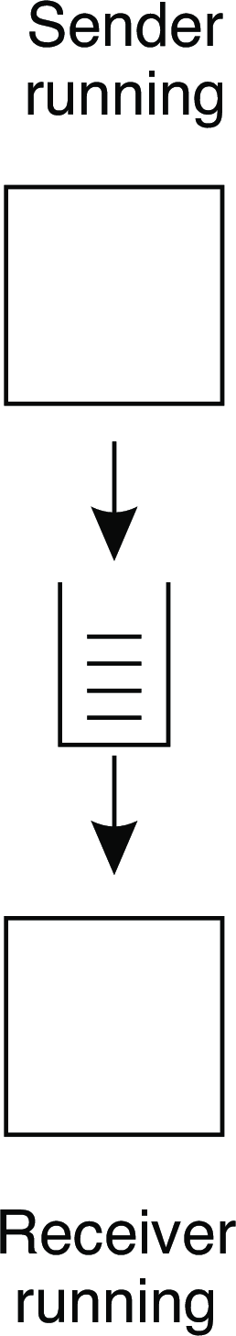
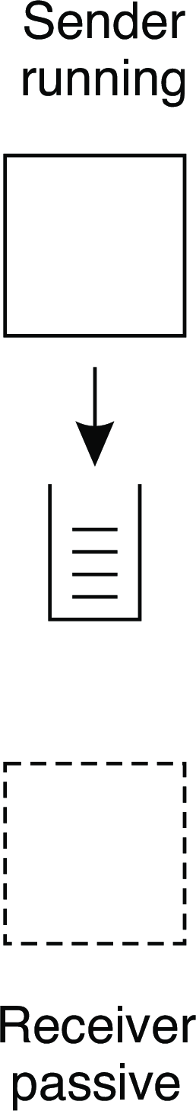
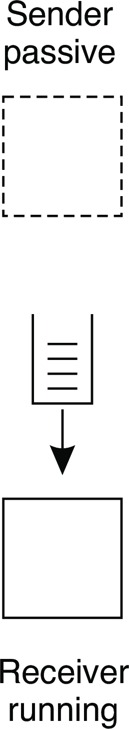
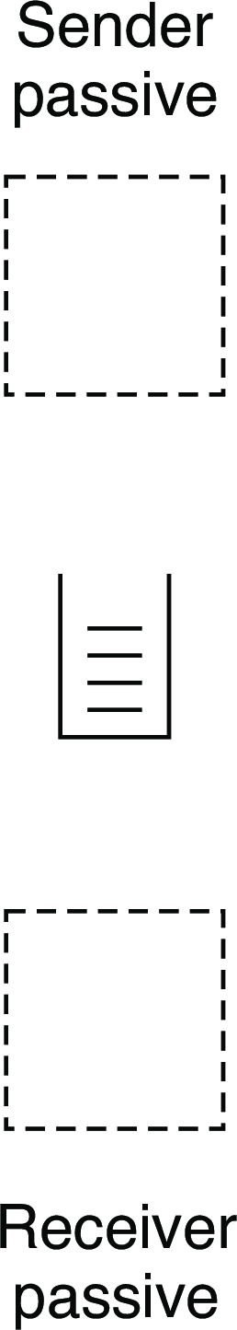
Communication
Message-oriented communication
Queue-based messaging
Four possible combinations
Message-oriented persistent communication

Slide 29
Message-oriented middleware
Communication Message-oriented communication
Essence
Asynchronous persistent communication through support of middleware-level queues. Queues correspond to buffers at communication servers.
Operations
Operation | Description
PUT | Append a message to a specified queue
GET | Block until the specified queue is nonempty, and remove the first message
POLL | Check a specified queue for messages, and remove the first. Never block
NOTIFY | Install a handler to be called when a message is put into the specified queue
Message-oriented persistent communication

Slide 30
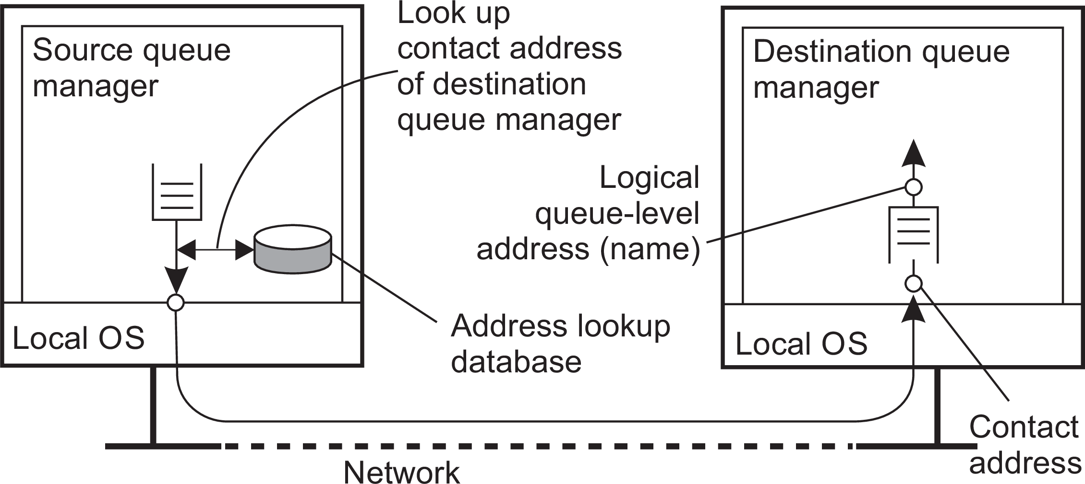
General model
Communication Message-oriented communication
Queue managers
Queues are managed by queue managers. An application can put messages only into a local queue. Getting a message is possible by extracting it from a local queue only ⇒ queue managers need to route messages.
Routing
Message-oriented persistent communication

Slide 31
Message broker
Communication Message-oriented communication
Observation
Message queuing systems assume a common messaging protocol: all applications agree on message format (i.e., structure and data representation)
Broker handles application heterogeneity in an MQ system
Transforms incoming messages to target format
Very often acts as an application gateway
May provide subject-based routing capabilities (i.e., publish-subscribe capabilities)
Message-oriented persistent communication

Slide 32
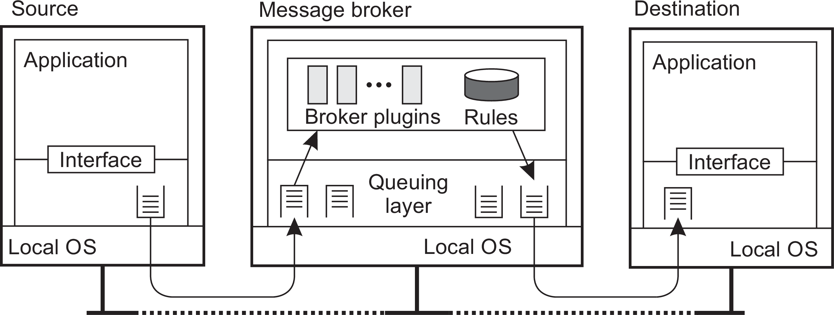
Communication
Message-oriented communication
Message broker: general architecture
Message-oriented persistent communication

Slide 33
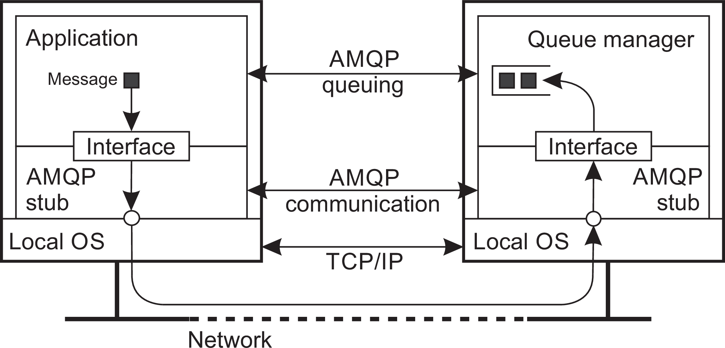
Example: AMQP
Communication Message-oriented communication
Lack of standardization
Advanced Message-Queuing Protocol was intended to play the same role as, for example, TCP in networks: a protocol for high-level messaging with different implementations.
Basic model
Client sets up a (stable) connection, which is a container for serveral (possibly ephemeral) one-way channels. Two one-way channels can form a session. A link is akin to a socket, and maintains state about message transfers.
Example: Advanced Message Queuing Protocol (AMQP)

Slide 34
Communication
Message-oriented communication
Example: AMQP-based producer
1 import rabbitpy
2
3 def producer():
4
5
6
7
8
9
10
11
12
13
14
15
16
17
18
19
20
21
connection = rabbitpy.Connection() # Connect to RabbitMQ server
channel = connection.channel() # Create new channel on the connection
exchange = rabbitpy.Exchange(channel, ’exchange’) # Create an exchange
exchange.declare()
queue1 = rabbitpy.Queue(channel, ’example1’) # Create 1st queue
queue1.declare()
queue2 = rabbitpy.Queue(channel, ’example2’) # Create 2nd queue
queue2.declare()
queue1.bind(exchange, ’example-key’) # Bind queue1 to a single key
queue2.bind(exchange, ’example-key’) # Bind queue2 to the same key
message = rabbitpy.Message(channel, ’Test message’) message.publish(exchange, ’example-key’) # Publish the message using the key exchange.delete()
Example: Advanced Message Queuing Protocol (AMQP)

Slide 35
Communication
Message-oriented communication
Example: AMQP-based consumer
1 import rabbitpy
2
3 def consumer():
4
5
6
7
8
9
10
11
12
13
14
15
16
17
18
19
20
connection = rabbitpy.Connection() channel = connection.channel()
queue = rabbitpy.Queue(channel, ’example1’)
# While there are messages in the queue, fetch them using Basic.Get
while len(queue) > 0:
message = queue.get()
print(’Message Q1: %s’ % message.body.decode()) message.ack()
queue = rabbitpy.Queue(channel, ’example2’)
while len(queue) > 0:
message = queue.get()
print(’Message Q2: %s’ % message.body.decode()) message.ack()
Example: Advanced Message Queuing Protocol (AMQP)

Slide 36
Application-level multicasting
Communication Multicast communication
Essence
Organize nodes of a distributed system into an overlay network and use that network to disseminate data:
Oftentimes a tree, leading to unique paths
Alternatively, also mesh networks, requiring a form of routing
Application-level tree-based multicasting

Slide 37
Application-level multicasting in Chord
Communication Multicast communication
Basic approach
Initiator generates a multicast identifier mid .
Lookup succ(mid ), the node responsible for mid .
Request is routed to succ(mid ), which will become the root.
If P wants to join, it sends a join request to the root.
When request arrives at Q:
Q has not seen a join request before ⇒ it becomes forwarder; P
becomes child of Q. Join request continues to be forwarded.
Q knows about tree ⇒ P becomes child of Q. No need to forward join request anymore.
Application-level tree-based multicasting

Slide 38
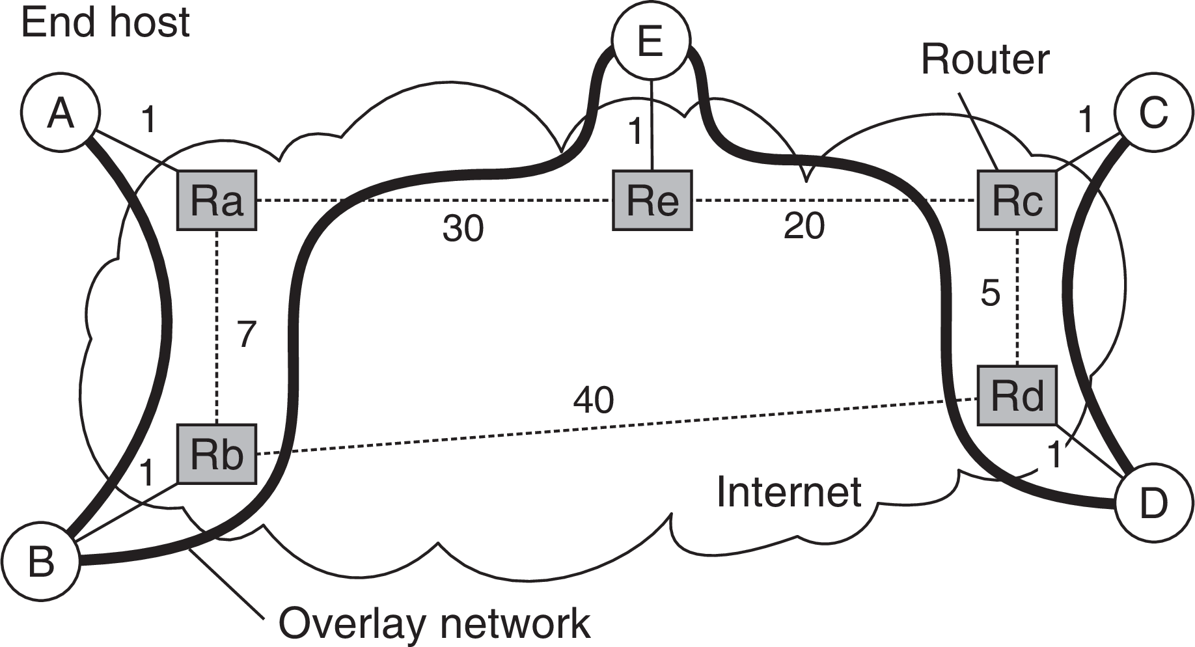
Communication
Multicast communication
ALM: Some costs
Different metrics
Link stress: How often does an ALM message cross the same physical link? Example: message from A to D needs to cross ⟨Ra, Rb⟩ twice.
Stretch: Ratio in delay between ALM-level path and network-level path. Example: messages B to C follow path of length 73 at ALM, but 47 at network level ⇒ stretch = 73/47.
Application-level tree-based multicasting

Slide 39
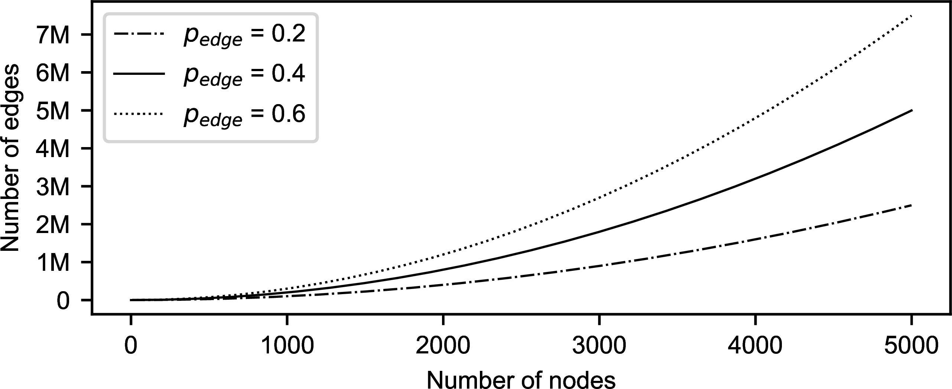
Flooding
Communication Multicast communication
Essence
P simply sends a message m to each of its neighbors. Each neighbor will forward that message, except to P, and only if it had not seen m before.
Flooding-based multicasting

Slide 40
Flooding
Communication Multicast communication
Essence
P simply sends a message m to each of its neighbors. Each neighbor will forward that message, except to P, and only if it had not seen m before.
Variation
Let Q forward a message with a certain probability p_{flood} , possibly even dependent on its own number of neighbors (i.e., node degree) or the degree of its neighbors.
Flooding-based multicasting

Slide 41
Communication
Multicast communication
Epidemic protocols
Assume there are no write–write conflicts
Update operations are performed at a single server
A replica passes updated state to only a few neighbors
Update propagation is lazy, i.e., not immediate
Eventually, each update should reach every replica
Two forms of epidemics
Anti-entropy: Each replica regularly chooses another replica at random, and exchanges state differences, leading to identical states at both afterwards
Rumor spreading: A replica which has just been updated (i.e., has been contaminated), tells several other replicas about its update (contaminating them as well).
Gossip-based data dissemination

Slide 42
Communication
Multicast communication
Anti-entropy
Principle operations
A node P selects another node Q from the system at random.
Pull: P only pulls in new updates from Q
Push: P only pushes its own updates to Q
Push-pull: P and Q send updates to each other
Observation
For push-pull it takes O(log(N)) rounds to disseminate updates to all N nodes (round = when every node has taken the initiative to start an exchange).
Gossip-based data dissemination

Slide 43
Anti-entropy: analysis
Communication Multicast communication
Basics
Consider a single source, propagating its update. Let p_{i} be the probability that a node has not received the update after the i^{th} round.
Analysis: staying ignorant
With pull, p_{i +1} = (p_{i} )²: the node was not updated during the i^{th} round and should contact another ignorant node during the next round.
With push, p = p (1 −
1 (N−1
)(1−p )
−1
i +1 i
)
i
≈ p e (for small p and large
N−1
i i
N): the node was ignorant during the i^{th} round and no updated node chooses to contact it during the next round.
With push-pull: (p_{i} )² · (p_{i} e⁻¹)
Gossip-based data dissemination

Slide 44
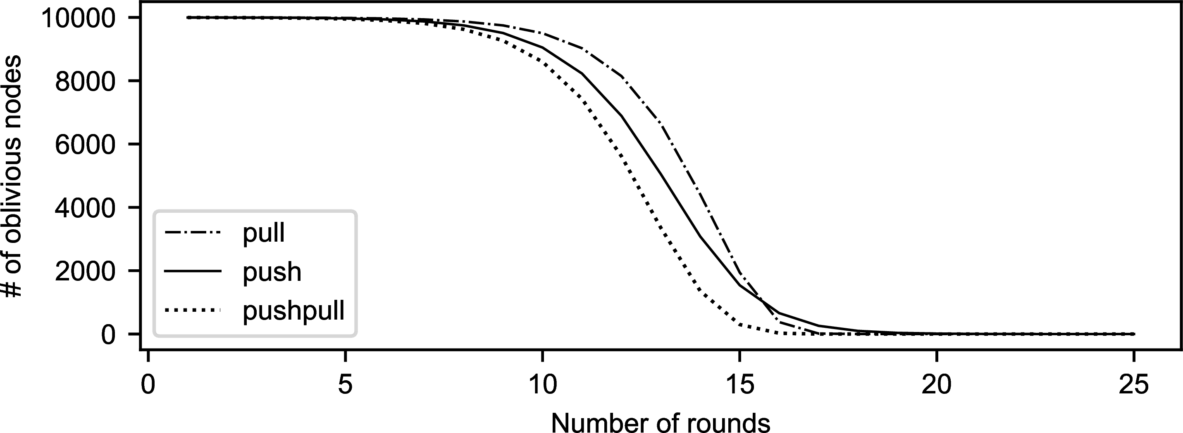
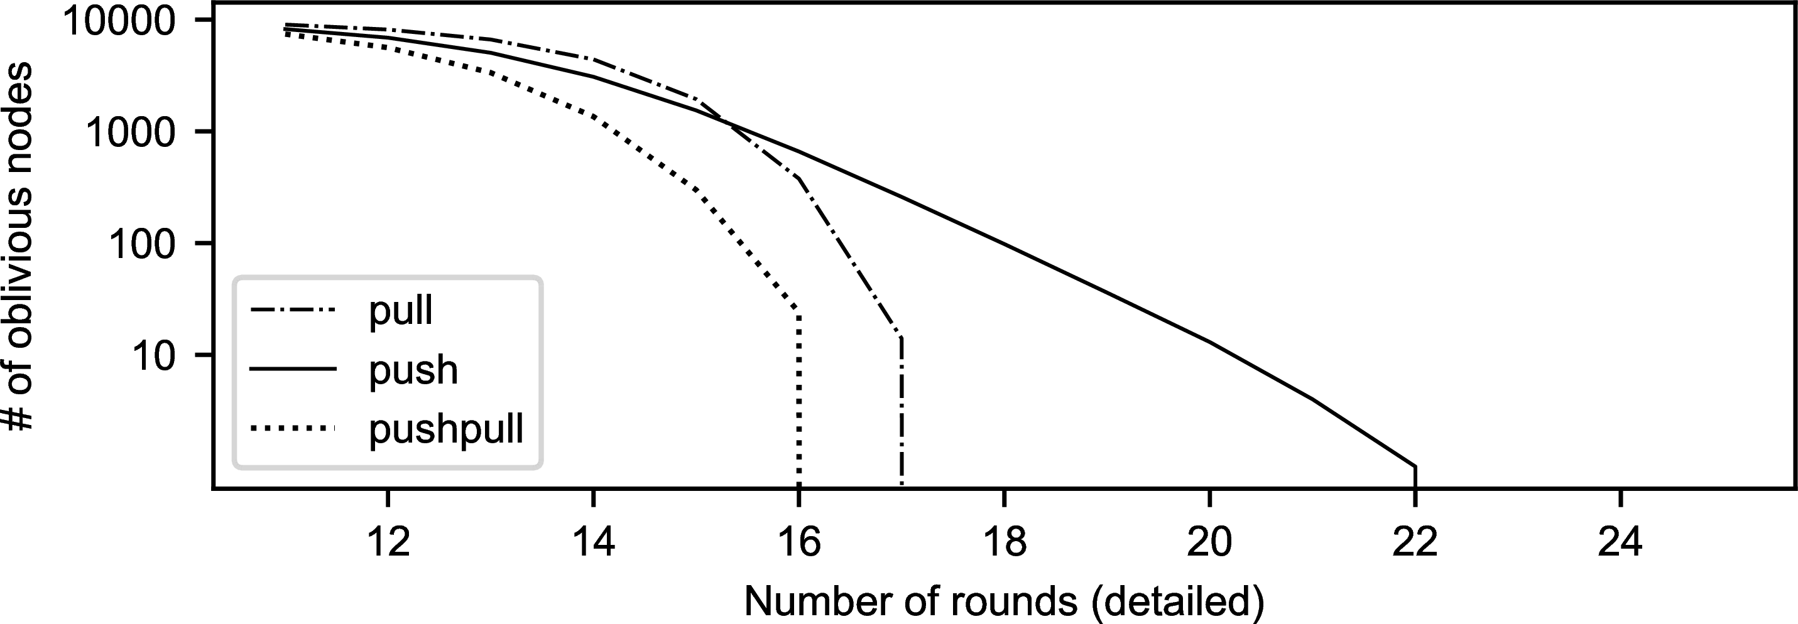
Communication
Multicast communication
Anti-entropy performance
Gossip-based data dissemination

Slide 45
Rumor spreading
Communication Multicast communication
Basic model
A server S having an update to report, contacts other servers. If a server is contacted to which the update has already propagated, S stops contacting other servers with probability p_{stop}.
Observation
If s is the fraction of ignorant servers (i.e., which are unaware of the update), it can be shown that with many servers
_{s = e}−(1/p_{stop}+1)(1−s)
Gossip-based data dissemination

Slide 46
Formal analysis
Communication Multicast communication
Notations
Let s denote fraction of nodes that have not yet been updated (i.e., susceptible; i the fraction of updated (infected) and active nodes; and r the fraction of updated nodes that gave up (removed).
From theory of epidemics
ds/dt
di/dt
⇒ di/ds
⇒ i (s)
= −s · i
= s · i −p_{stop} · (1 −s) · i
=
=
^{p}stop
−(1 + p_{stop}) +
s
−(1 + p_{stop}) · s + p_{stop} · ln(s) + C
Wrap up
i (1) = 0 ⇒ C = 1 + p_{stop} ⇒ i (s) = (1 + p_{stop}) · (1 −s) + p_{stop} · ln(s). We are looking for the case i (s) = 0, which leads to s = e^{−(1/pstop+1)(1−s)}
Gossip-based data dissemination

Slide 47
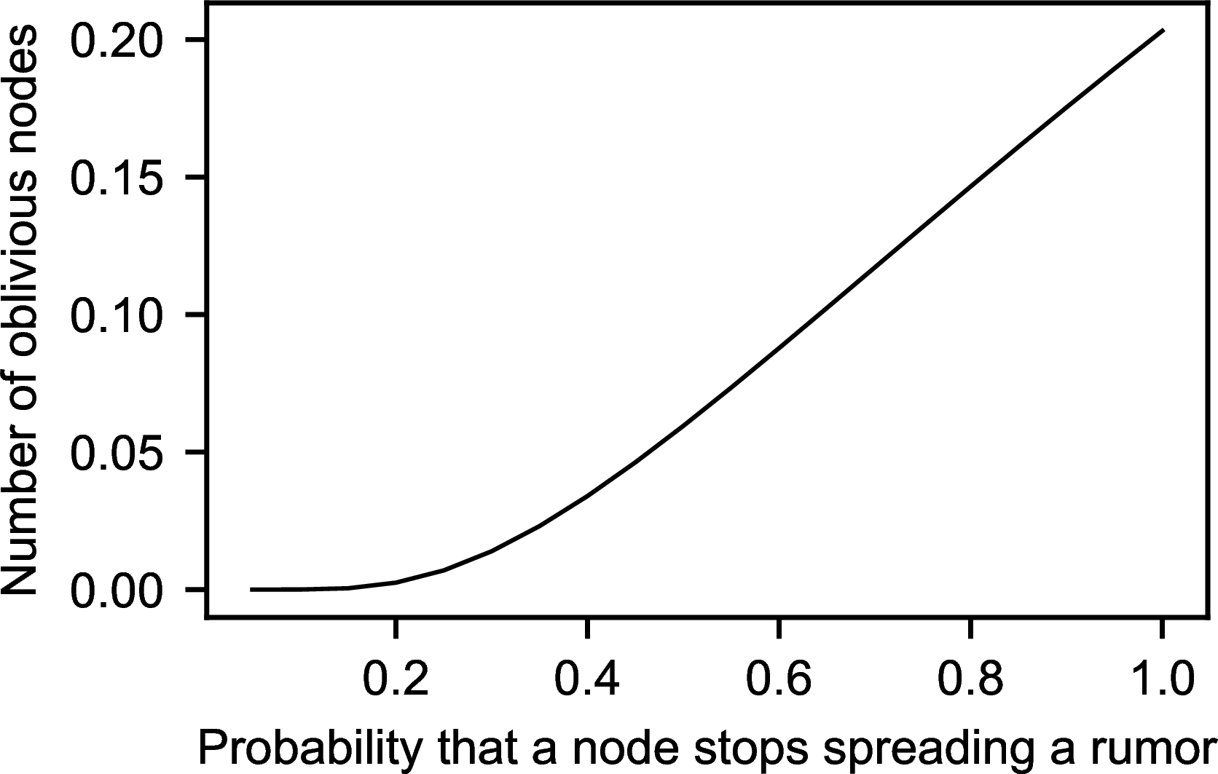
Communication
Multicast communication
Rumor spreading
The effect of stopping
Consider 10,000 nodes
^{1/p}stop | s | Ns
1 | 0.203188 | 2032
2 | 0.059520 | 595
3 | 0.019827 | 198
4 | 0.006977 | 70
5 | 0.002516 | 25
6 | 0.000918 | 9
7 | 0.000336 | 3
Gossip-based data dissemination

Slide 48
Communication
Multicast communication
Rumor spreading
The effect of stopping
Consider 10,000 nodes
^{1/p}stop | s | Ns
1 | 0.203188 | 2032
2 | 0.059520 | 595
3 | 0.019827 | 198
4 | 0.006977 | 70
5 | 0.002516 | 25
6 | 0.000918 | 9
7 | 0.000336 | 3
Note
If we really have to ensure that all servers are eventually updated, rumor spreading alone is not enough
Gossip-based data dissemination

Slide 49
Deleting values
Communication Multicast communication
Fundamental problem
We cannot remove an old value from a server and expect the removal to propagate. Instead, mere removal will be undone in due time using epidemic algorithms
Solution
Removal has to be registered as a special update by inserting a death certificate
Gossip-based data dissemination

Slide 50
Deleting values
Communication Multicast communication
When to remove a death certificate (it is not allowed to stay for ever)
Run a global algorithm to detect whether the removal is known everywhere, and then collect the death certificates (looks like garbage collection)
Assume death certificates propagate in finite time, and associate a maximum lifetime for a certificate (can be done at risk of not reaching all servers)
Note
It is necessary that a removal actually reaches all servers.
Gossip-based data dissemination

